Slide 1
Climate Change Economics
Emission reduction
Scenarios
Costs
Instruments
Impacts of climate
Impacts and valuation
Total and marginal costs
Impacts and development
Climate policy
Optimal climate policy
Secondary benefits
Discounting, equity, uncertainty

Slide 2
Emission Reduction
Emissions and emission reduction
Costs of emission reduction
Modelling choices
Policy choices
Double dividend
Instruments for emission reduction

Slide 3
Abatement Costs
Abatement costs are real and positive
Without climate policy, emissions are free – with climate policy, emissions are costly
Alternatively, climate policy puts an additional constraint on the energy system – if the constraint bites, costs necessarily increase

Slide 6
Gross global product: $75 trillion, NPV $3750 trillion

Slide 7
Abatement Costs -2
Abatement costs are higher if
The economy is less responsive because elasticities are lower or because capital lasts longer
There are fewer options to reduce emissions
The costs of emission reduction options are higher
The costs of emission reduction options fall more slowly over time
The rate of cost decline does not respond to climate policy
Abatement costs are uncertain because we have little experience

Slide 8
Emission Reduction
Emissions and emission reduction
Costs of emission reduction
Modelling choices
Policy choices
Stringency
Participation
Timing
Double dividend
Instruments for emission reduction

Slide 10
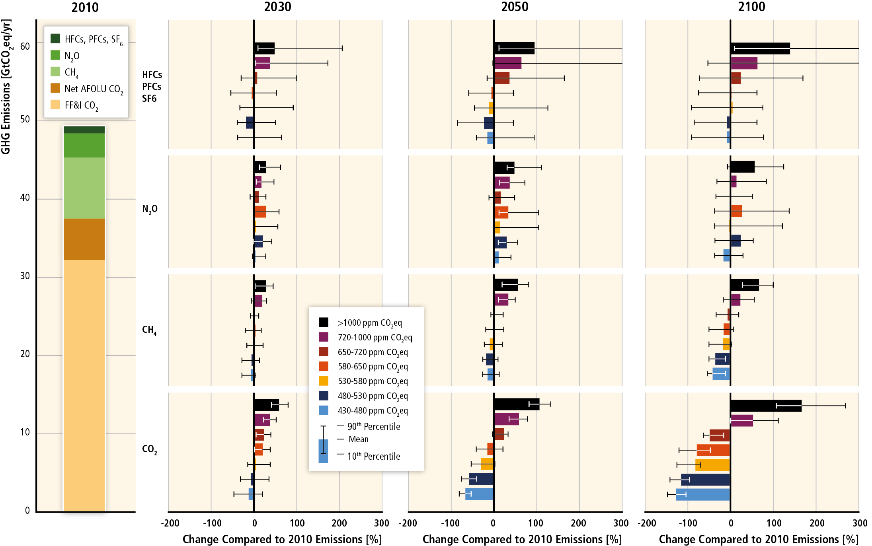

Slide 11
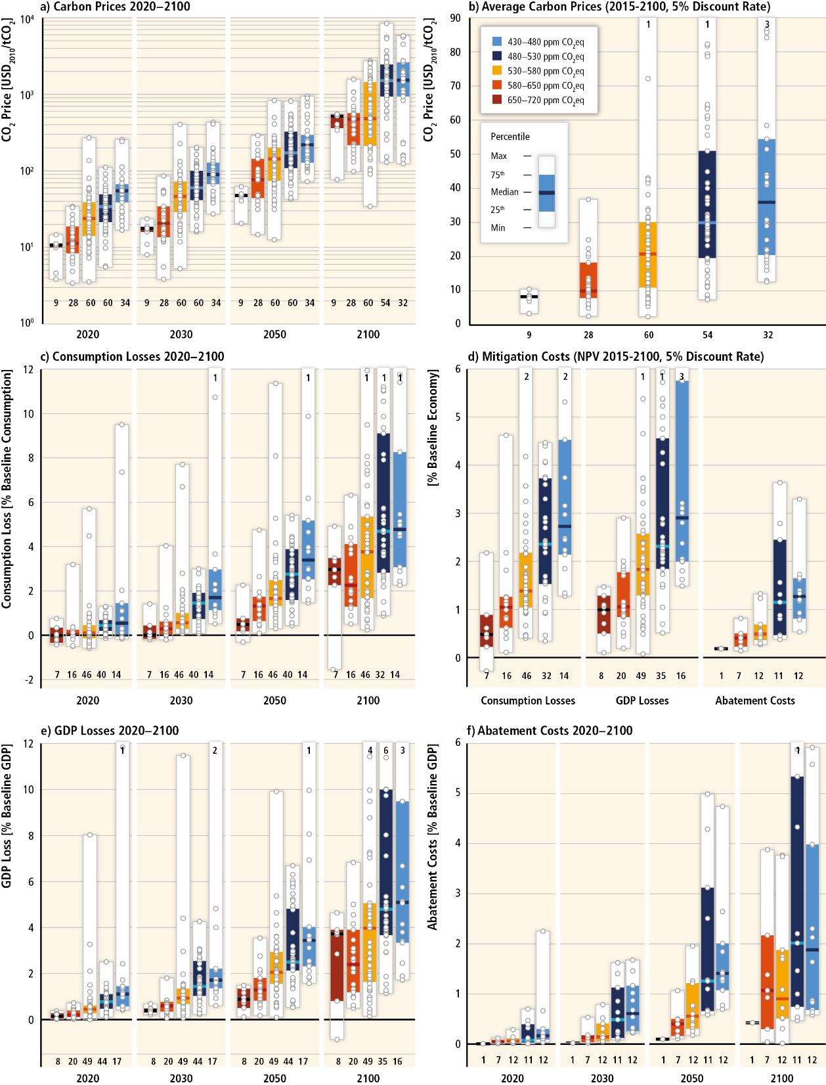

Slide 13
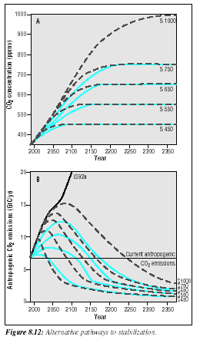
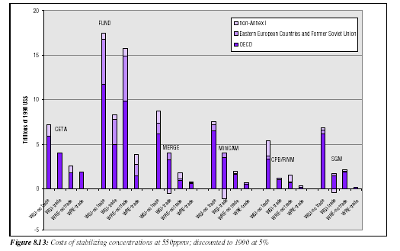
It is better to start slow because:
Capital stock turnover
Technological progress
Discount rate
Carbon cycle

Slide 14
Emission Reduction
Emissions and emission reduction
Costs of emission reduction
Modelling choices
Policy choices
Double dividend
Instruments for emission reduction

Slide 15
Negative Abatement Costs
There are claims that we could reduce emissions and save money
Most of this is bogus
Confusion of market forces and policy

Slide 17
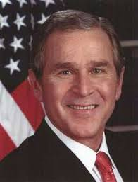
Negative Abatement Costs
There are claims that we could reduce emissions and save money
Most of this is bogus
Confusion of market forces and policy
Ignore process innovation
Inappropriate discount rates
Omission of hidden costs

Slide 18
Negative Abatement Costs
Most economic models are optimisation models or assume perfect markets
If you’re in the optimum, any policy would increase costs
If the starting point is an imperfect market, costs may be positive or negative
Negative costs arise if climate policy reduces the overall market failure, or if the carbon tax reduces the overall distortion by the fiscal system

Slide 19
Distortions
A tax is more distortionary if
Tax base is narrower
Price elasticity is higher
Deadweight loss of a tax is roughly quadratic in the level of the tax
Raising the carbon tax distorts the economy, but probably not by that much
The carbon tax revenue can be used to reduce another tax – this would at least partly but maybe more than offset the costs of the carbon tax
This is the revenue-recycling effect

Slide 20
Distortions
Assume that the labour tax is reduced
A labour tax reduces labour demand (as it drives up before-tax wages) and labour supply (as it drives down after-tax wages)
A reduced labour tax thus increases employment and welfare
The revenue-recycling effect is positive
This is the second dividend
Lower emissions is the first dividend

Slide 21
Distortions
There is third effect
A carbon tax means more expensive energy
Higher prices reduce real income
The supply of labour falls with the reward for labour
This is the tax-interaction effect: The carbon tax makes the labour tax worse
In certain theoretical models, the tax-interaction effect is always larger than the revenue-recycling effect

Slide 23
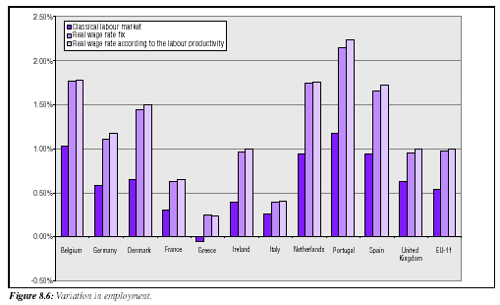

Slide 24
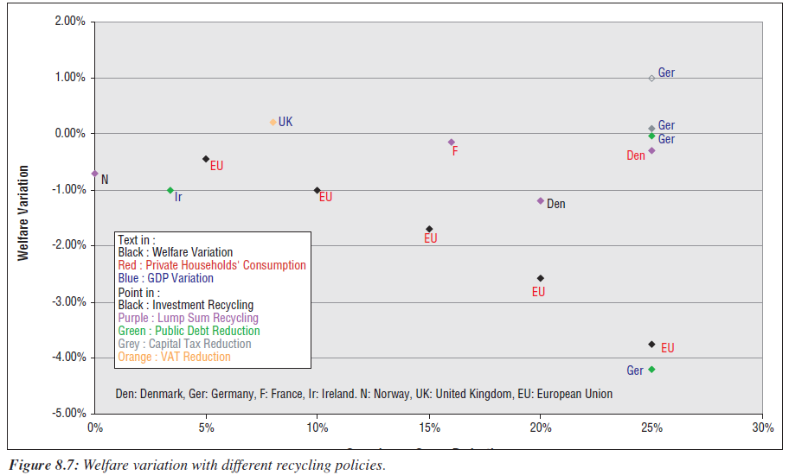

Slide 25
Recycling Taxes: Change in 2010 GDP due to a $40/tC tax
 | DRI | LINK | DGEM | Goul.
Lump sum | -0.58 | -0.46 | -0.62 | -0.24
Spend | -0.40 | -1.02 |  | -0.24
Pers. Inc. | -0.56 | -0.53 | -0.16 | -0.16
Corp. Inc. | 0.40 | -0.11 | 0.60 | -0.17
Payroll |  |  |  | -0.18
Pay – employee | -0.58 | -0.53
Pay – employer | 0.19 | -0.25
Inv. Cred. | 1.55 | 1.67 |  | 0.00

